Slide 1


New type of devices for identification of users of “Raiffeisen ONLINE” – Hardware and Software Tokens

Slide 2
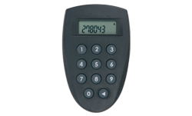

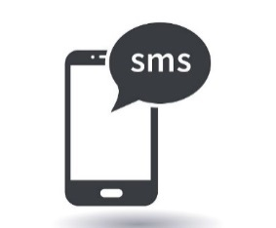
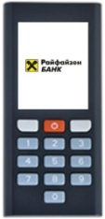

New type of tokens
Raiffeisen Bank will be providing its customers new type of Tokens.
The changes are regulatory requirement in compliance with the Payment Service Directive 2 2015/2366.
Since September 13th 2019 current tokens won’t be used for authorization in Raiffeisen ONLINE. Users with current Tokens will be able to remotely migrate via Raiffeisen ONLINE to one of the following options:
Additional security tools – possible options:
Option 1 – SMS authorization
Option 2 – Raiffeisen Token
Hardware token
Price according to the Tariff for legal entities
Software Token
Free application

Slide 3
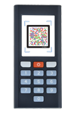
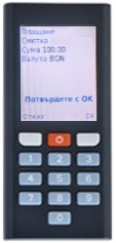
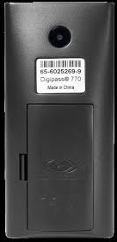
New type of hardware Tokens
The new type of Hardware Tokens provide the following main features:
Scanning camera for images generated by Raiffeisen ONLINE;
Display for visualization of main payment requisites – required to be confirmed (Beneficiary’s IBAN, Amount and Currency);
Activation via Raiffeisen ONLINE by the User itself;
Deactivation by the User itself;
Language options (Bulgarian and English);
Battery replacing possibility;
The device can be purchased from an office of the Bank after 02.09.2019
One token could be used from 8 users

Slide 4

New type of software Tokens
The new type of software Tokens – mobile application for Android and iOS “Raiffeisen Token” provides the following features:
Cost-free application on Google Play Store and App Store;
Activation via Raiffeisen ONLINE by the User itself;
Deactivation by the User itself;
Language options (Bulgarian and English);
Possibility for Payment authorization in two modes – Online and Offline;
The application could be downloaded after 12.09.2019
One user could use at the same time software and hardware tokens

Slide 5
Software Tokens – Signing modes
Offline mode
Online mode
The process is identical to the process of the Hardware Token (Internet connection is not necessary).
Payment order via Raiffeisen ONLINE;
Raifeisen ONLINE generates an image;
The User loads the application “Raiffeisen Token” on its phone;
The User scans the image generated by Raiffeisen ONLINE;
The User enters the PIN code for the application;
Raiffeisen Token displays the payment requisites (IBAN, amount and currency) and generates 8-digit code;
The User enters the generated 8-digit code on Raiffeisen ONLINE and authorize the payment.
Online mode requires Internet connection on the mobile device which has the application Raiffeisen Token installed.
Order a payment via Raiffeisen ONLINE;
Raiffeisen ONLINE sends a notification on the mobile device, which has the application Raiffeisen Token installed;
The User receives and opens the Push-notification;
After entering the PIN code for the application - Raiffeisen Token displays the payment requisites (IBAN, Amount and Currency);
The User confirms the payment with a click on the “Confirm” button;
For authorizing the payment the Customer has to log in on Raiffeisen ONLINE, then go to the menu “Waiting”.

Slide 6
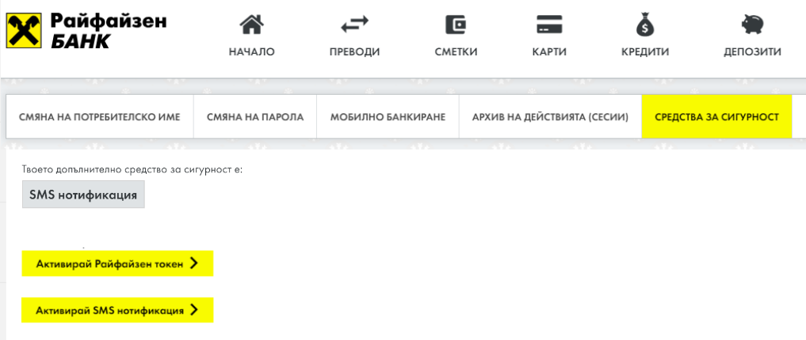
User migration from current Token to a new one or SMS authorization
We’ve provided the opportunity for our Clients who are still using their current Token to migrate remotely via Raiffeisen ONLINE from13.09.2019 to one of the following options:
The new Raiffeisen Tokens ( in case of migration to Hardware Token the Customer should visit an office to purchase it);
Confirmation through SMS authorization;
Токен

Slide 7
User migration from current Token to a new one or SMS authorization
To be able to migrate to one of the two options the Customers should log in Raiffeisen ONLINE and then go to “Customer profile” afterwards - menu “ Security devices”:
1/ Choose one of the options: “Activate Raiffeisen Token” or “Activate SMS Notification”
2/ Authorization through an old Hardware Token – Raiffeisen ONLINE displays a “Request” code which the User enters on the Token;
3/ The Token generates an “Answer” code which the User enters on Raiffeisen ONLINE;
4/ The User enters:
a mobile phone number for receiving via SMS an activation code for the Token;
or
a mobile phone number for receiving SMS authorization codes;
5/The user follows the Token activation steps through scanning images.

